Slide 1
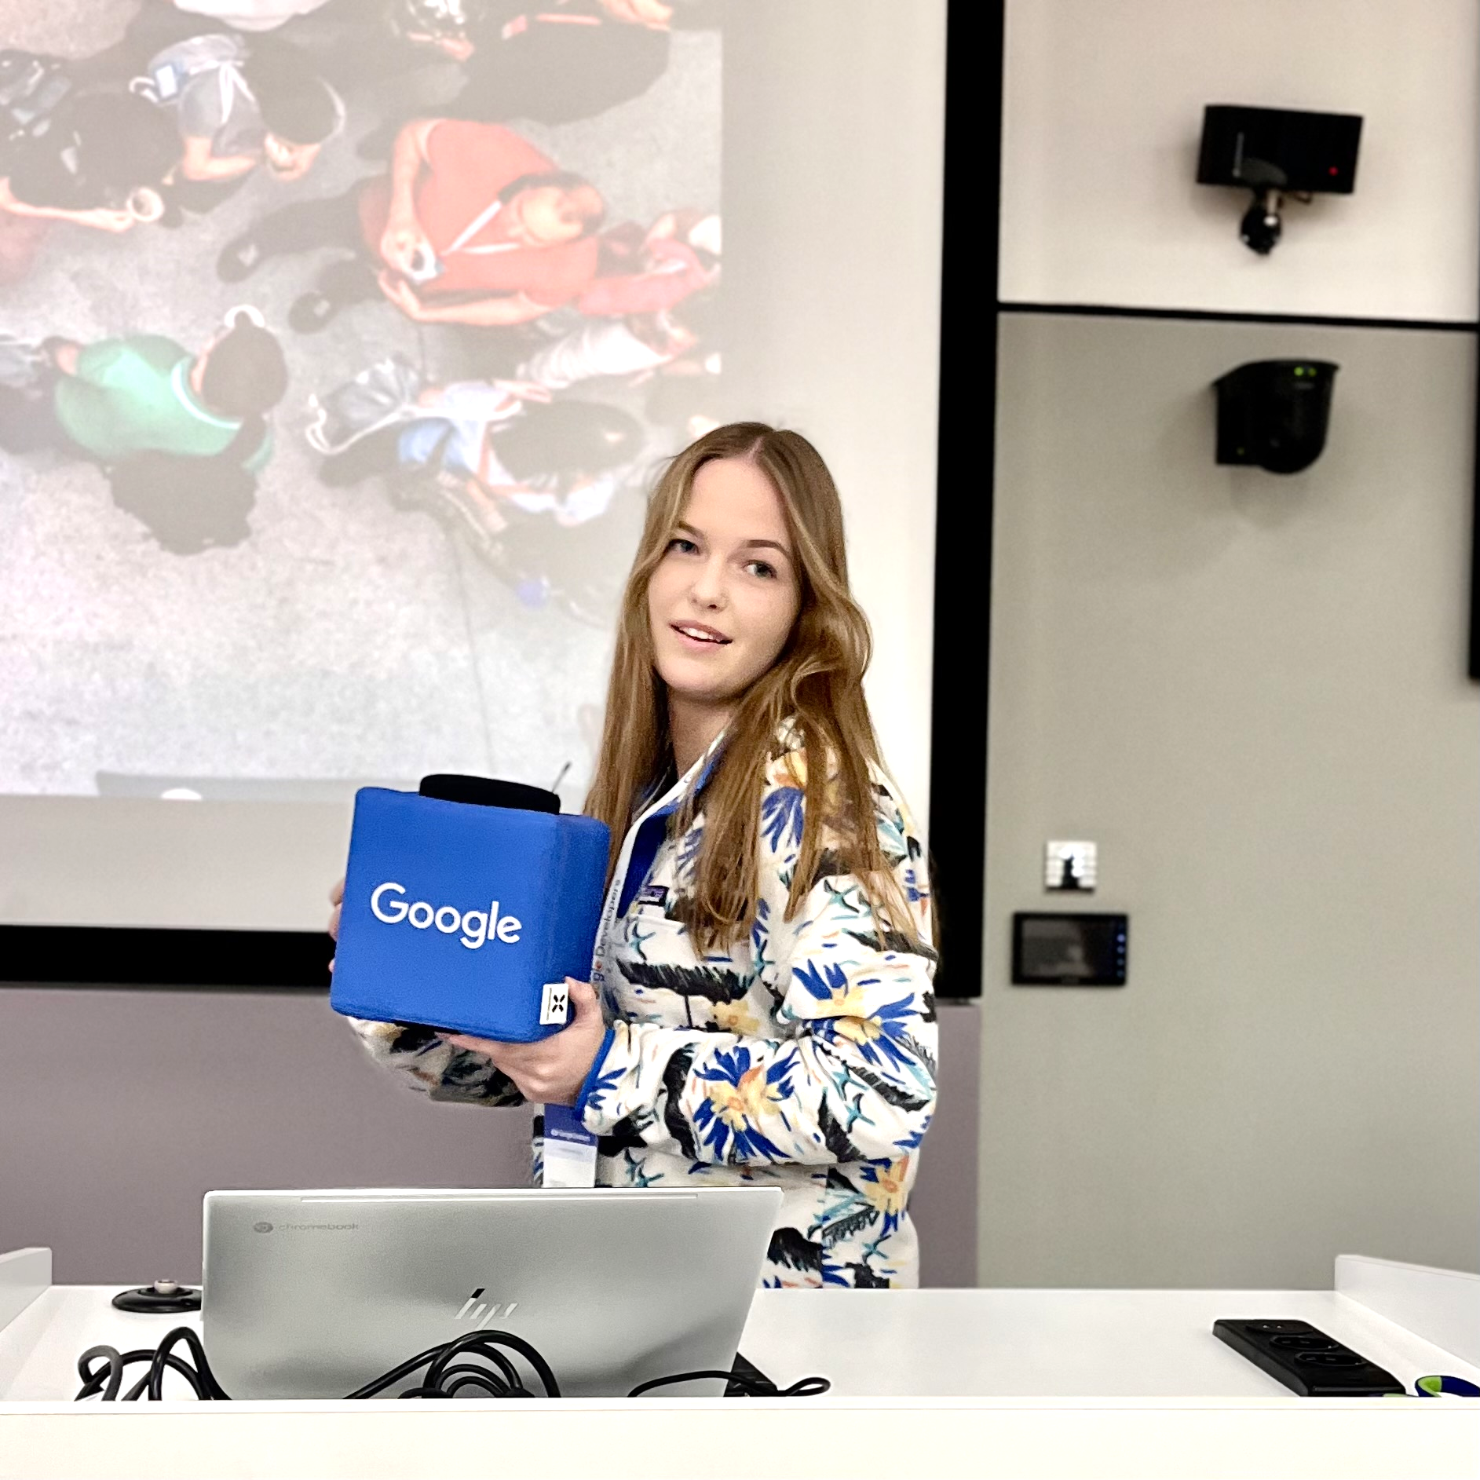
Make Perfetto Perfect: Interaction to Next Paint
Patricija Cerkaite
Eindhoven University of Technology
@Patricijia
Notes:
Hello everyone, my name is Patricija and today I’m going to talk how to make perfetto perfect by adding interaction to next paint to it.

Slide 2
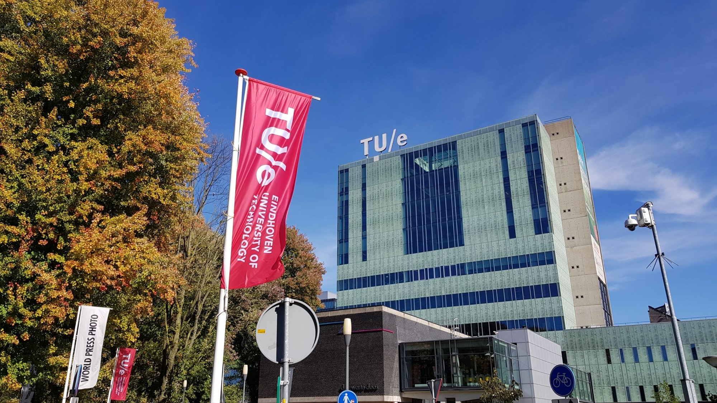
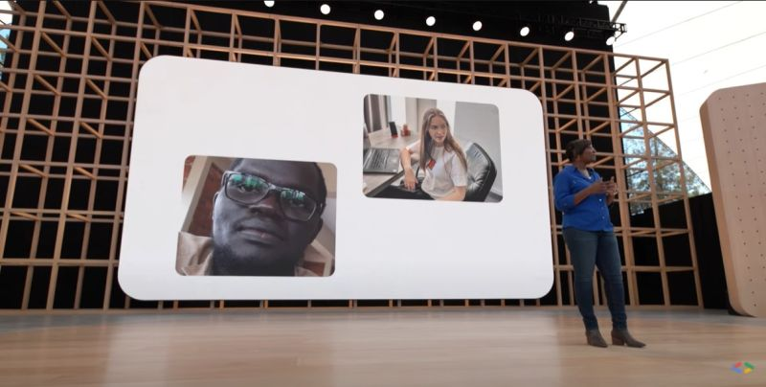
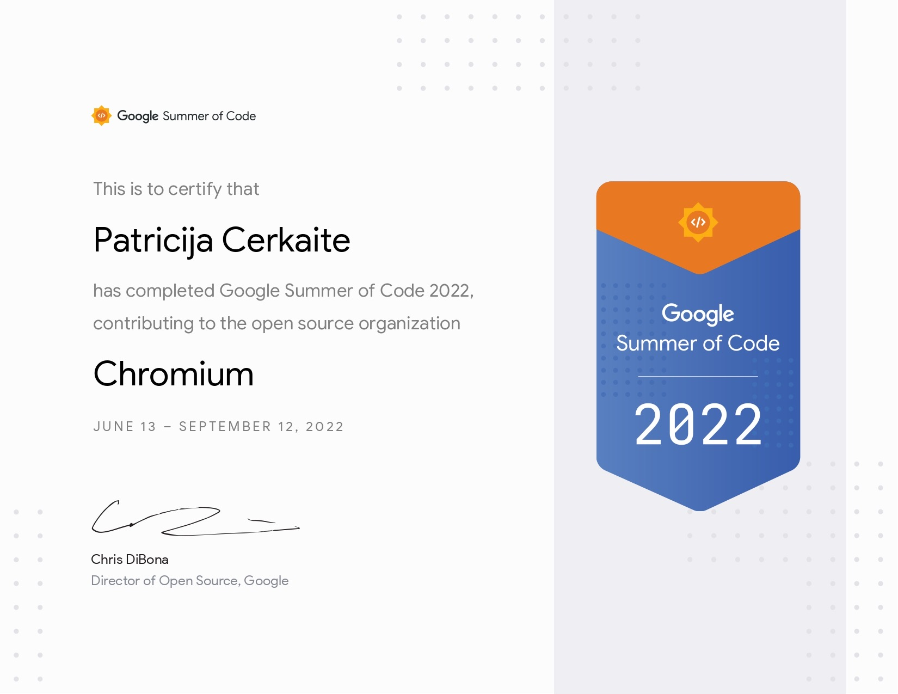
Lithuania
Vilnius
Eindhoven University of Technology
Netherlands
Google I/O Developer Keynote
GDSC Lead
Google Summer of Code
Chromium
Tracing Summit
Today
Microsoft
Dropped Frames Detector
Sustainability Metric
Notes:
A bit about my background. I’m from Lithuania, Vilnius moved to the Netherlands - to study Computer Science at the Eindhoven University of Technology. To be honest, studying and all automata theory was a bit boring for me therefore I joinsd Google Developers community, started organising developer events for students and one of them and got mentioned in the Google IO Developer Keynote for that. But why that Google IO is important? Mainly because in the same Google IO Chrome Web Performance Team introduced experimental Metric - INP (that I just mentioned). Together with the some members of the team we worked in the Chromium Organisation to add metric to perfetto. Performance took my attention so much that I worked on it whenever I could even during the internal Microsoft Global Hackathon I worked on Dropped Frames Detector and Sustainability Metric. And today I’m here ready to explain metrics on INP.

Slide 3
Google Summer of Code is a global, online mentoring program focused on introducing new contributors to open source software development.
Notes:
Global, online mentoring program
Contributors work on a 12+ week programming project in their open source organization
Open to anyone
Chromium organisation, 12 weeks medium size project
Give contributors exposure to real-world software development scenarios (testing, version control, software licensing, distributed development, etc.).
Contributors work on medium sized projects (~175 hours) or large projects (~350 hours).

Slide 4
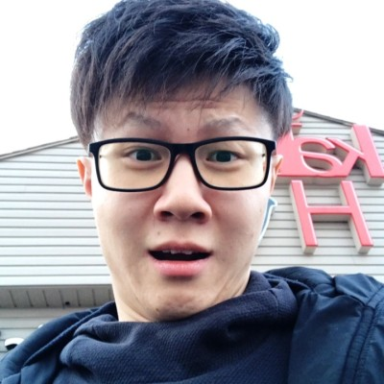
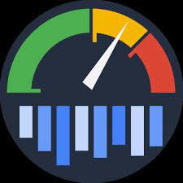
Make Perfetto Perfect: Interaction to Next Paint Metric
Team |  | Goals Provide more details of INP Metric to developers Analyse other ways of calculating INP Score Visualize INP on Perfetto UI | Organisation
Mentor
Michal Mocny
Mentor
Aoyuan Zuo
Mentor
Lan Wei
Contributor
Patricija Cerkaite
Chrome Speed
Metrics Team
Perfetto Discord Community
Notes:
Team
Goals:
Provide more details of INP Metric to developers
Analyse other ways of calculating INP Score
Visualize INP on Perfetto UI
Organisation

Slide 5
What is INP?
Agenda
Responsiveness and INP
Metrics on Perfetto
Adding INP Metric to Perfetto

Slide 6
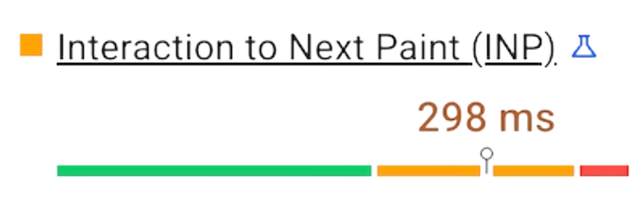
What is Interaction to Next Paint?
Interaction to Next Paint (INP) is an experimental full-page lifecycle metric that assesses responsiveness.
Notes:
an experimental full-page lifecycle metric that assesses responsiveness

Slide 7
Responsiveness
Good responsiveness means that a page responds quickly to interactions made with it.
Notes:
What is responsiveness?
responsiveness brings understanding how fast a webpage responds to user input
try to open a meniu on a web page how long does it take before it appears to be doing something at all
Good responsiveness means - web page responds quickly to interactions made with it.
changes in the user interface can be seen in the visual feedback in the next frame a browser presents.
example of good versus poor responsiveness:
At the left long tasks blocks meniu from opening.
user clicks multiple times thinking that the meniu is broken. H
main thread catches up it - processes delayed inputs resulting in meniu opening and closing unexpectedly.

Slide 8
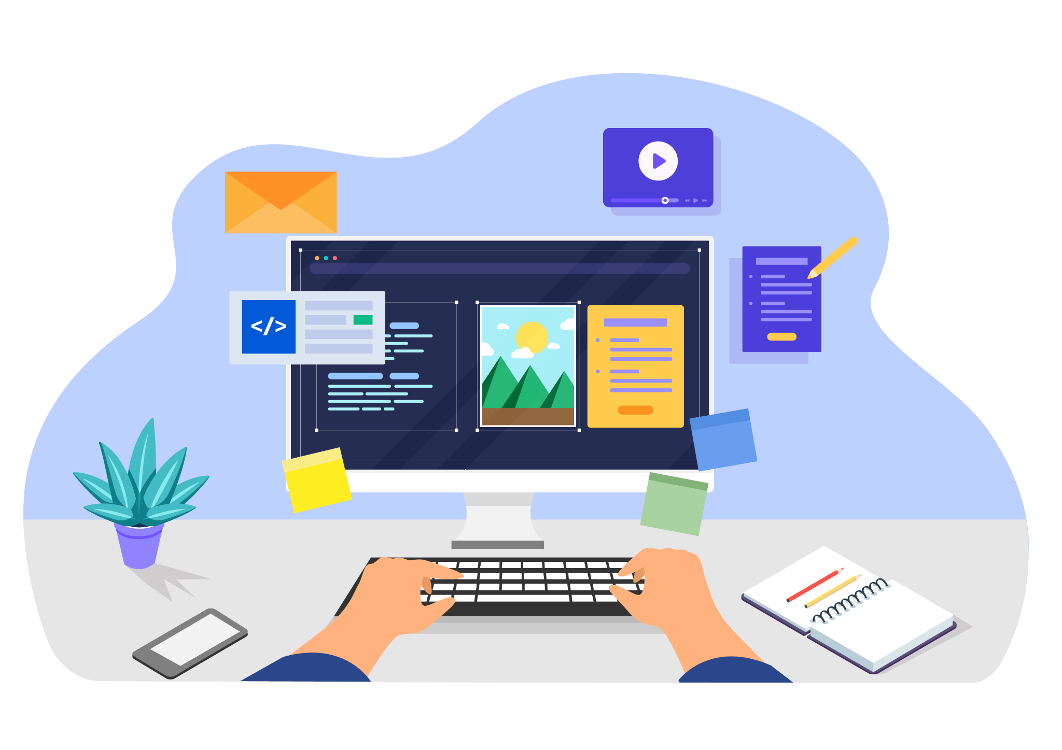
Responsiveness in INP
INP aims to represent a page's overall responsiveness by measuring all click, tap, and keyboard interactions made with a page.
Notes:
INP aimt to represent a page’s overall responsiveness by measuring all click, tap and keyboard interactions, made with a page.
Some examples of such interactions can be:
Clicking with a mouse;
Tapping on a device with a touchscreen;
Pressing a key on either a physical or onscreen keyboard.
For each page load only the discrete event types that we call are included into INP. It is important to know that we omit continuous events such as drag or scroll.

Slide 9
Responsiveness in INP
Interaction
Not included
pointer up
pointer down
drag
scroll
click
Discrete Events
Continuous Events
Notes:
The group of discrete events’ event handlers that fire during the same logical user gesture form a one interaction.
"tap" interactions on a touchscreen device: pointerup , pointerdown, and click.
for each page load only the discrete event types are included / omit continuous events such as drag or scroll.
An interaction can be driven by JavaScript, CSS, built-in browser controls (such as form elements), or a combination thereof.

Slide 10
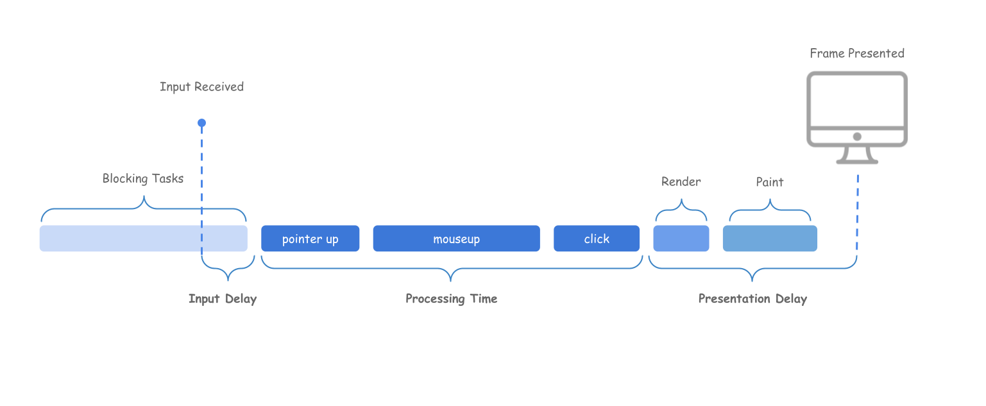
Interaction Timings
MAX (pointerup, mouseup, click)
Notes:
The total sum of the latency (of the interaction) is made up of these three time spans:
The input delay: the time between when a user interacts with the page and when event handlers are executed.
Processing time: the total amount of time it takes to execute code in associated event handlers. - We take the largest processing time of one event
The presentation delay: this is the time between when the event trades finish executing and when the browser displays the next frame.

Slide 11
What's a "good" INP value?
The largest duration of page loads.
Notes:
What's a "good" INP value?
We take the largest duration of page loads - the largest event timings of them all.
below or at 200 ms means that your page has good responsiveness.
between 200 ms and 500 ms means that your page's responsiveness needs improvement.
500 ms means that your page has poor responsiveness.

Slide 12
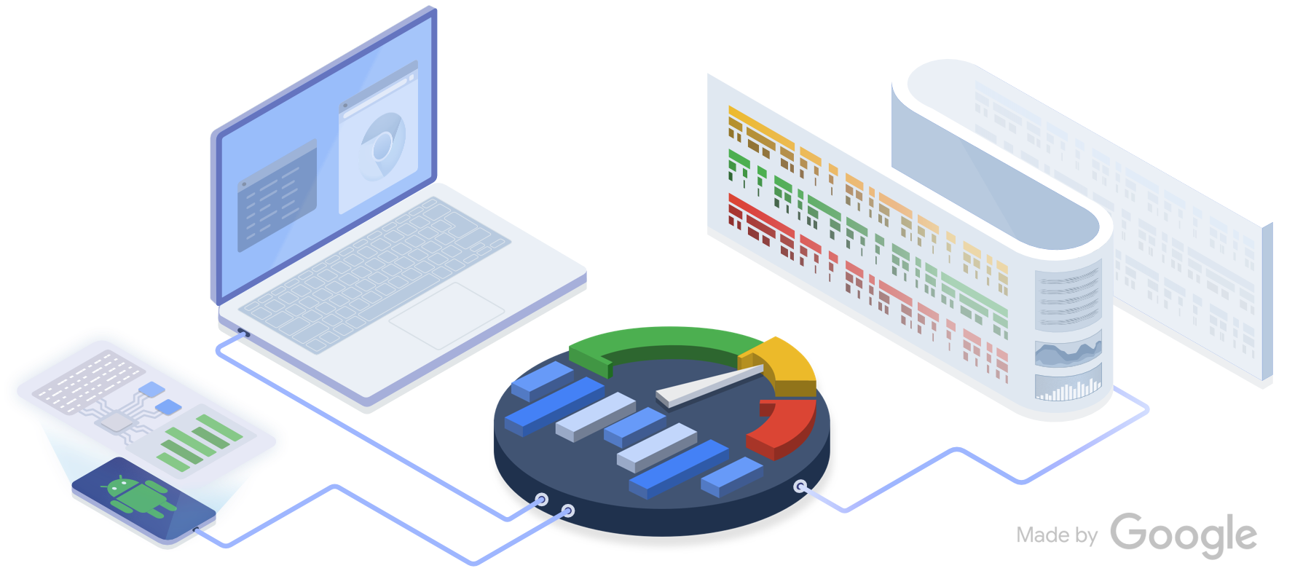
With Perfetto we can do more than that…

Slide 13
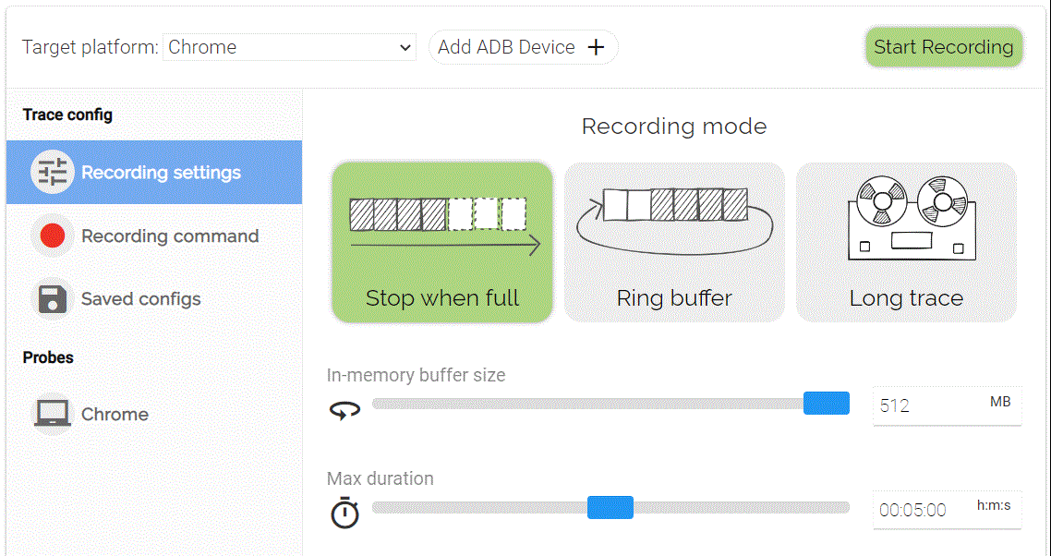
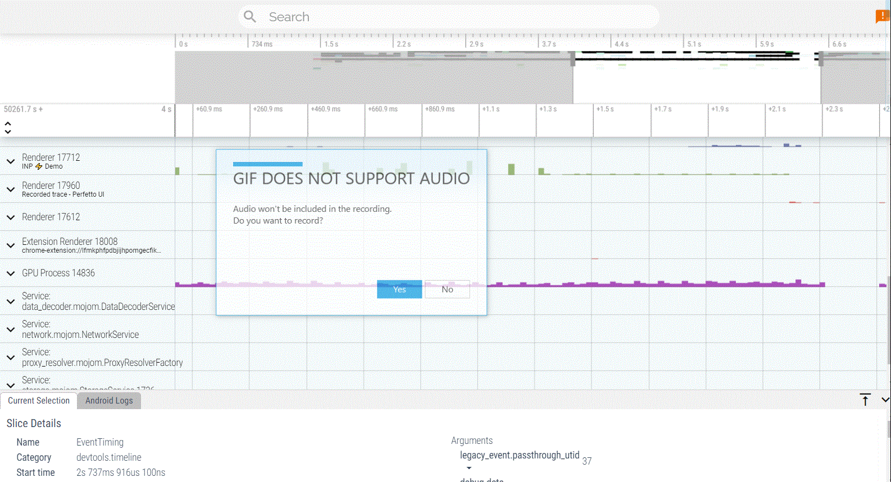
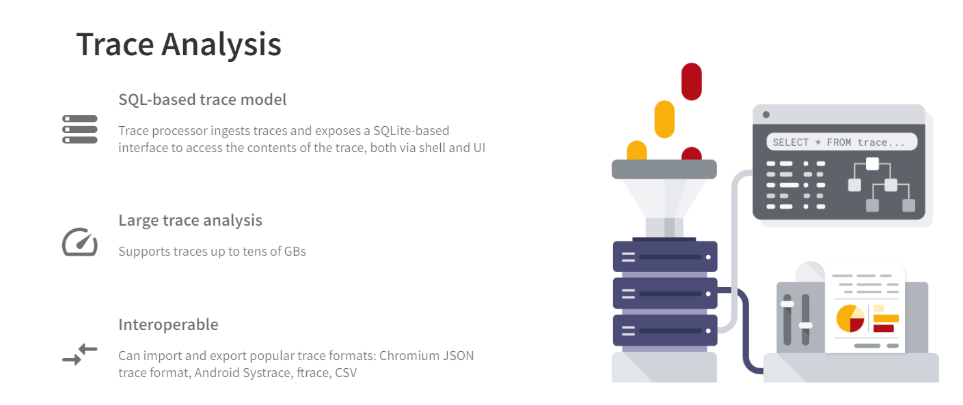
Record a Website
Analyse Event Timings
Use SQL to define INP
SELECT slice.*,
FROM slice
WHERE name = "EventTiming"
Notes:
Firstly we trace a web page on Perfetto: an open source-stack for performance instrumentation and trace analysis
The devtools.timeline checkmark allow us to obtain all the information about event timings
Key functionality in this project: metrics is a subsystem of a trace processor
query all details about the trace events containing in a consistent set of tables

Slide 14
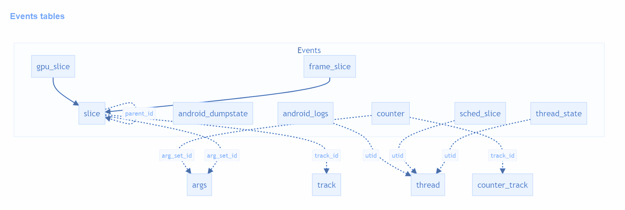
SQL Tables
InteractionId
processingStart
processingEnd
Notes:
slice table: extract all kinds of information about event timings such as event duration, timestamp
for each event I could obtain more information by joining arguments table with slice table:
the ID that uniquely identifies the user interaction which triggered the associated event
processingStart/processingEnd: a timestamp captured at the beginning/end of the event dispatch algorithm

Slide 15
-- Find all event timings
DROP VIEW IF EXISTS event_timings;
CREATE VIEW event_timings AS
SELECT
ts AS event_start_ts,
ts + slice.dur AS event_end_ts,
dur AS event_dur,
EXTRACT_ARG(arg_set_id, 'debug.data.timeStamp') * 1000000 AS time_stamp,
EXTRACT_ARG(arg_set_id, 'debug.data.processingStart') * * 1000000 AS processing_start,
EXTRACT_ARG(arg_set_id, 'debug.data.processingEnd') * * 1000000 AS processing_end,
EXTRACT_ARG(arg_set_id, 'debug.data.interactionId') AS interaction_id,
EXTRACT_ARG(arg_set_id, 'debug.data.type') AS event_type,
process_track.upid
FROM slice
INNER JOIN process_track ON slice.track_id = process_track.id
WHERE slice.name = "EventTiming"
ORDER BY ts;
Notes:
Create Event_timings table where - all the events during the tracing period.
Slice name is Event Timing.
Join slice table and process table
Extract arguments - timestamp, processing start, processing_end, interaction_id

Slide 16
-- Find inp metric based on using ANY event with first processing time and first timestamp.
DROP VIEW IF EXISTS interaction_frames;
CREATE VIEW interaction_frames AS
SELECT
COUNT(CASE WHEN interaction_id > 0 THEN 1 END) AS interaction_count,
GROUP_CONCAT(interaction_id) AS interaction_ids,
GROUP_CONCAT(event_type) AS event_types,
(MIN(processing_start) - MIN(time_stamp)) AS input_delay,
(MAX(processing_end) - MIN(processing_start)) AS processing_time,
(event_end_ts - (MIN(event_start_ts)- MIN(time_stamp) + MAX(processing_end))) AS presentation_delay,
MIN(event_start_ts) AS event_start_ts,
event_end_ts,
event_dur
FROM event_timings
GROUP BY event_end_ts
HAVING interaction_count > 0;
Notes:
create another view called interaction frames event_timings.
group interactions by the event_end_ts. (all of them belongs to the very same frame displayed to the user.)
need to count how many interactions are presented in one frame, number must be larger than 0
calculate 3 components of each frame: input delay, processing time and presentation delay.

Slide 17
Demo Time:
Notes:
The SQL can be ran in the sql console implemented in the perfetto ui, however to get more freedom, ability to analyze data with python and obtain larger tables I was happy to use Google Colab.

Slide 18
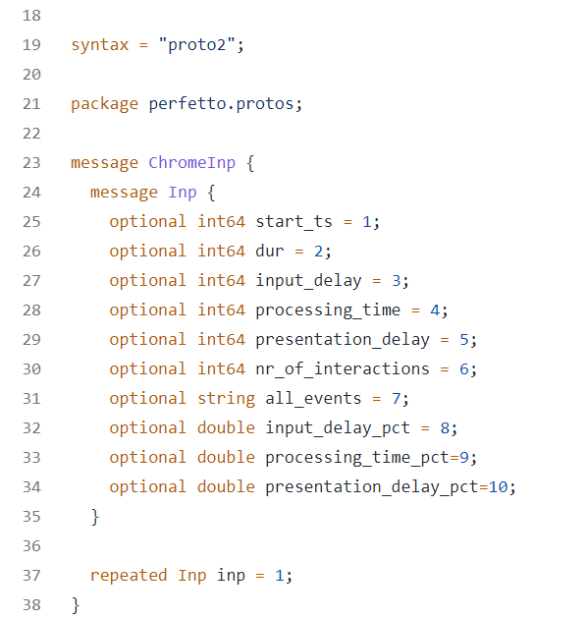
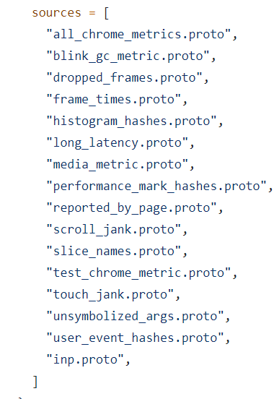
Add a new trace-based metric
inp.proto
1
BUILD.gn
Create the proto file containing the metric in the protos/perfetto/metrics/chrome folder and update BUILD.gn file.
Notes:
create a proto file where we define everything that should be displayed in the metric
all the basic information such as timestamp,duration of all three durations per frame.
useful variable is all_events where - all types of events that were displayed in the same frame as well as their ID’s
calculate the percentage of each input delay, processing time and presentation delay

Slide 19
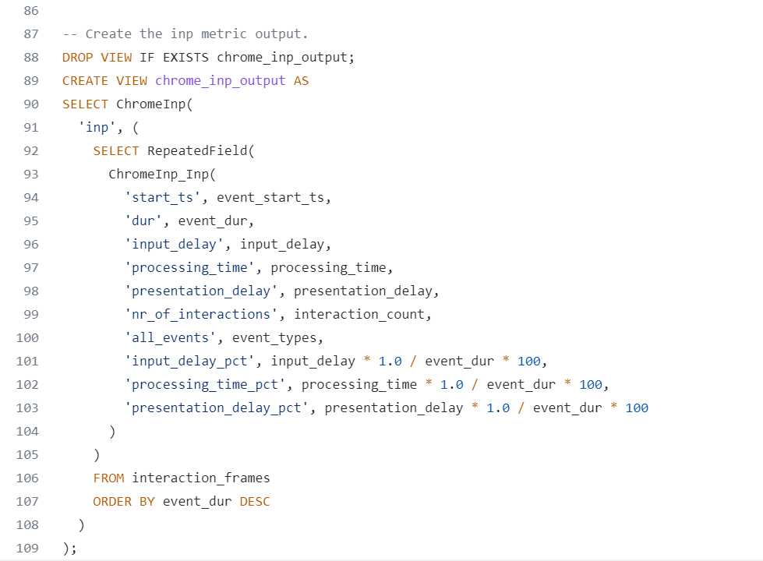
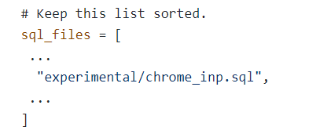
Add a new trace-based metric
2
chrome_inp.sql
BUILD.gn
Add a new INP SQL file for the metric to src/trace_processor/metrics/sql/experimental and update the BUILD.gn file.
Notes:
added a new view where we pass all the arguments of interaction_frames table, calculate those percentages

Slide 20
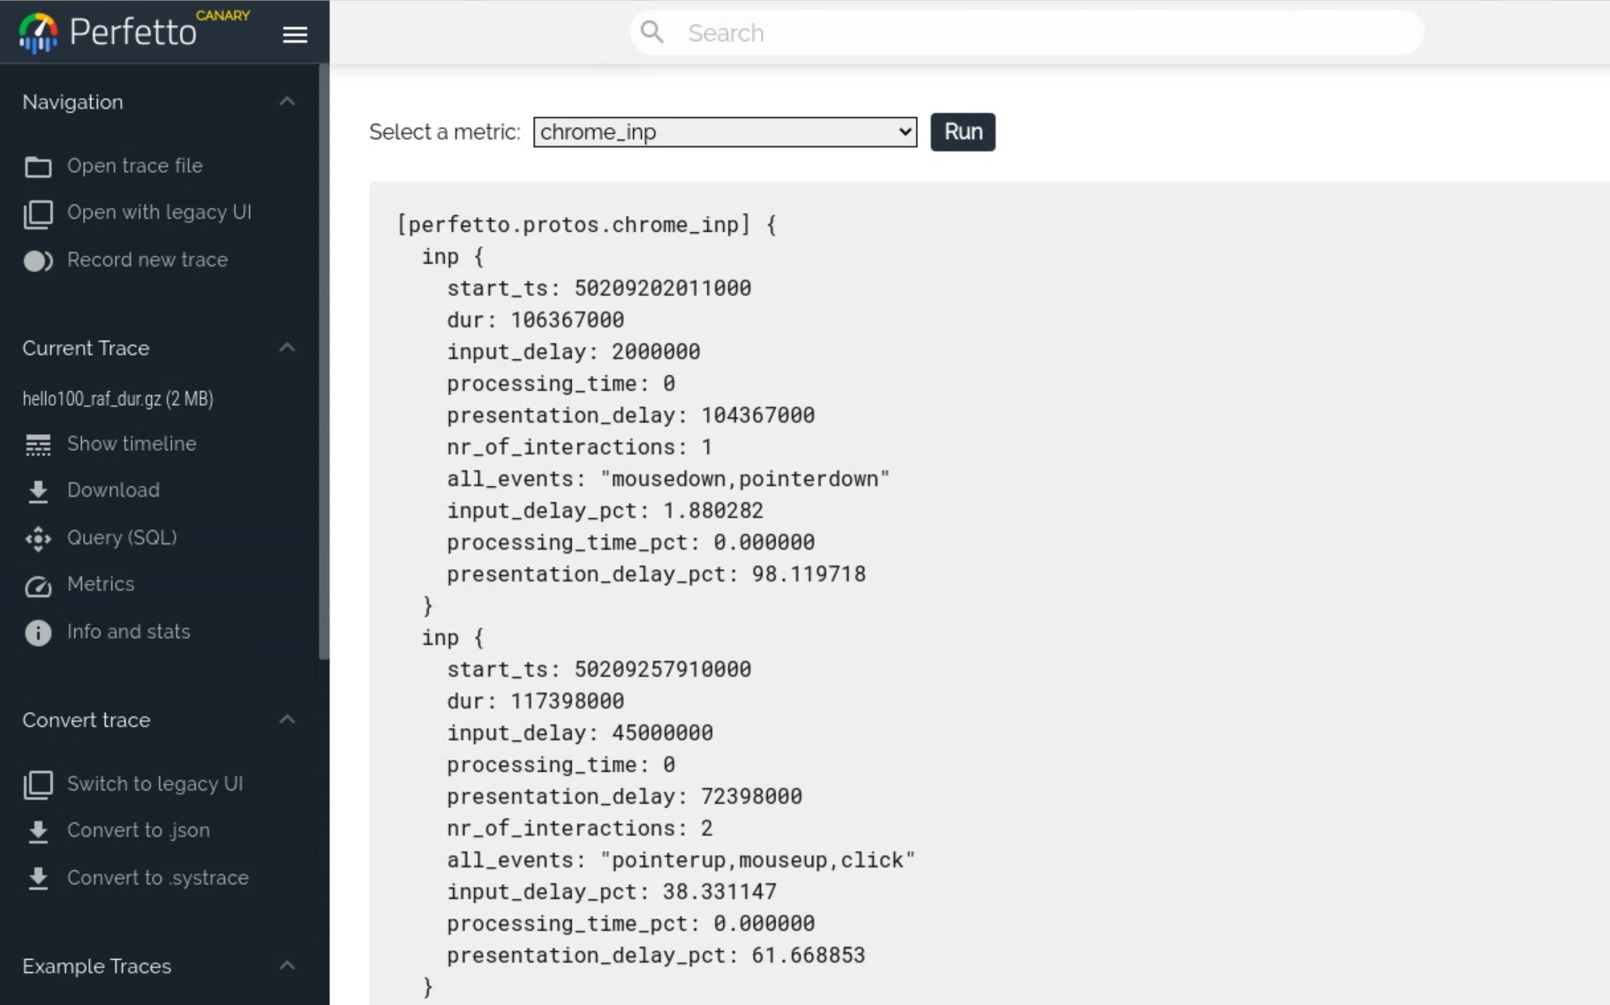
Result
Notes:
Only by adding 2 files and doing some minor adjustments we can get everything we need about inp.

Slide 21
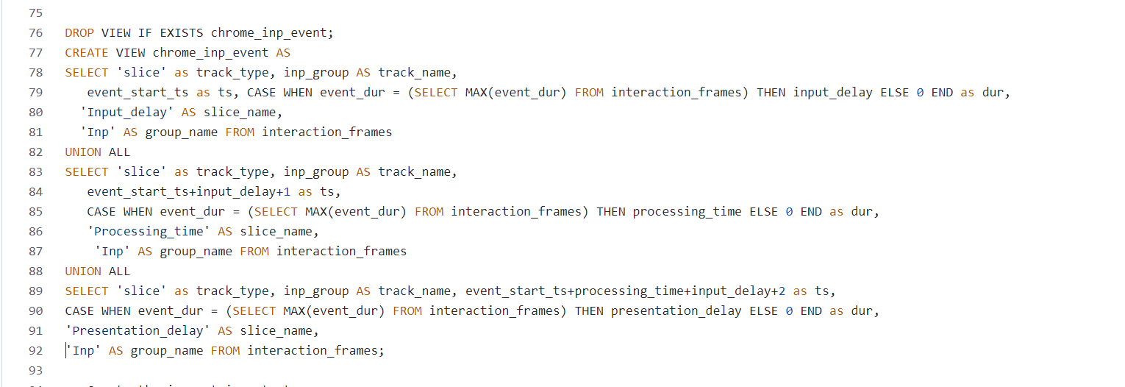
Adding new derived events
3
Create a new view with the name chrome_inp_event in the chrome_inp.sql file
chrome_inp.sql
Notes:
Issues:
timestamps cannot overlap,
metrics timelines overlap
We fully draw the durations of the largest inp metric and all others are just timestamp points.

Slide 22
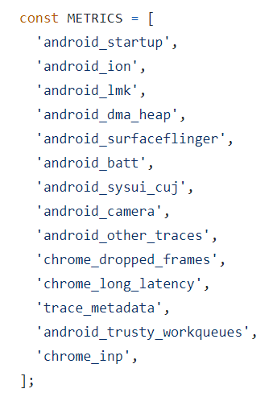
Adding new derived events
4
List the inp metric in the initialiseHelperViews method of trace_controller.ts. in ui/src/controller/trace_controller.ts directory
Notes:
Add metric to the trace controller and run

Slide 23
ui/run-dev-server: INP Metric on Perfetto

Slide 24
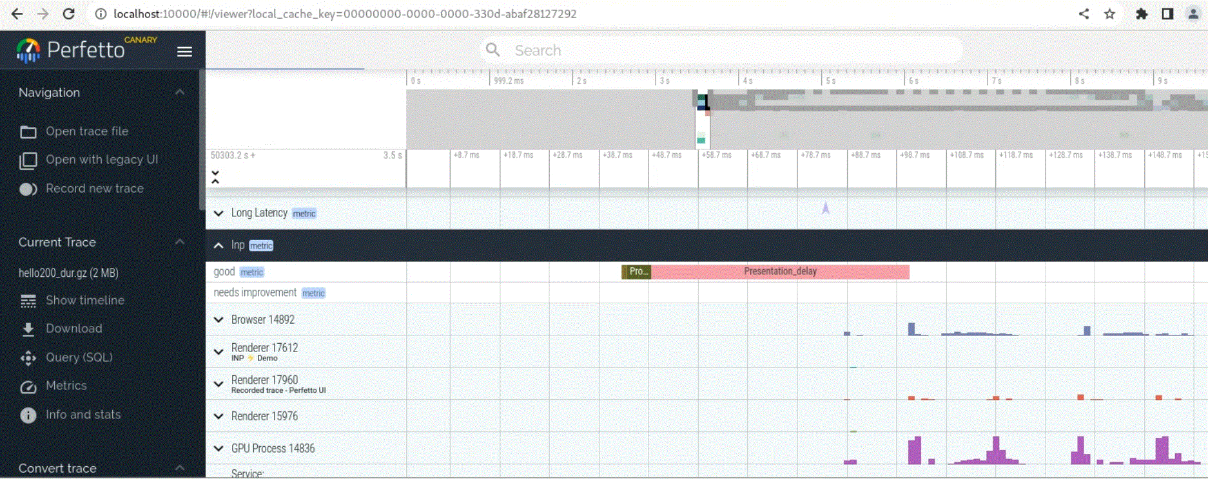
Result

Slide 25
Improvements
INP Metric Layout in the timeline Display the durations of input delay, processing time, presentation delay without overlaps. | Add multiple ways to measure processing time Taking maximum processing time of one discrete event is not the most robust way. | Implement / Improve oher Metrics on Perfetto Implement Core Web Vitals, Improve Dropped frame metric to obtain better overview
Input Delay
Processing Time
Presentation Delay
Tap

Slide 26
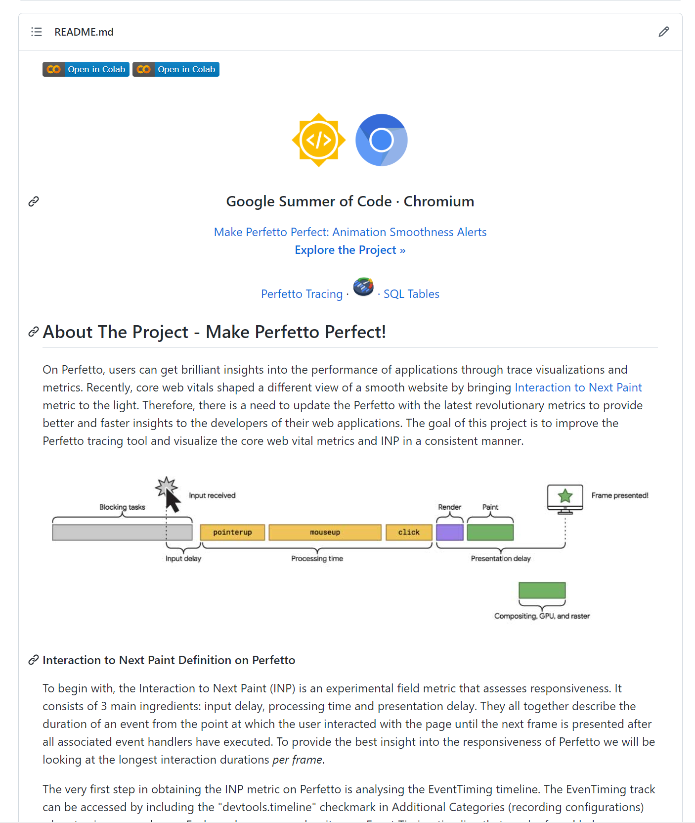
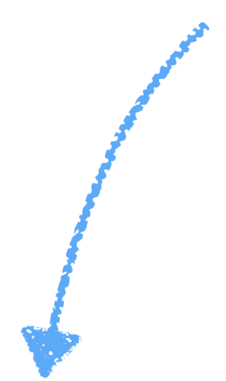
https://github.com/Patricijia/GSoC-Perfetto-Metrics
Thank you!

